Slide 1
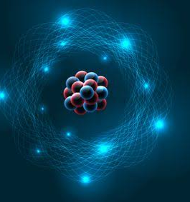

HISTORY OF ATOMIC STRUCTURE

Slide 2
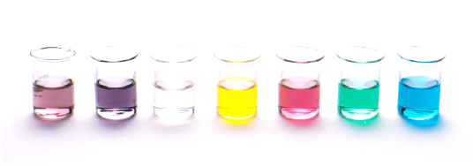
Outline
Findings from a range of scientific experiments contributed to the understanding of the atom, enabling scientists, including Dalton, Thomson, Rutherford, Bohr and Chadwick to develop models of atomic structure and make reliable predictions about the mass, charge and location of the sub-atomic particles. (SHE)

Slide 3
Early Theories
The Greeks and Hindus appear to have developed theories on matter.
Most of the writings are attributed to the Greeks due to the amount of recorded information that has survived to the present.
Greeks thought substances could be converted or transformed into other forms.
They observed the changing of states due to heat and equated it with biological processes.
The Greeks were philosophers and thinkers, not experimentalists, so they did not conduct experiments to verify their ideas.

Slide 4
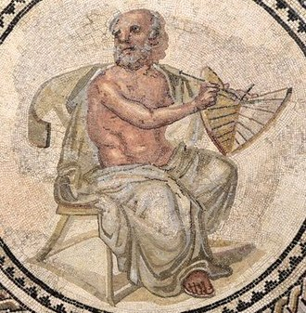


Thales of Miletus
(about 624-about 527 B.C.)
Proposed that water is the primal matter from which everything originated.
Anaximander
(610-546 B.C.)
The primary substance, the apeiron, was eternal and unlimited in extension. It was not composed of any known elements and it possessed eternal motion (i.e., a soul).
Anaximenes
(585-524 B.C.)
Stated that air is the primary substance
Suggested it could be transformed into other substances by thinning (fire) or thickening (wind, clouds, rain, hail, earth, rock).

Slide 5

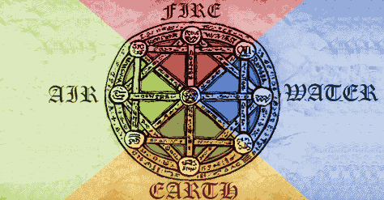
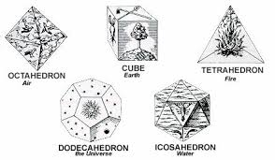
Heraclitus of Ephesus
(544-484 B.C.)
fire is the primeval substance
Change is the only reality.
Empedocles of Agrigentum
(492-432 B.C.)
Credited with the first announcement of the concept of four elements: earth, air, fire, and water, which were capable of combining to form all other substances.
Elements combined by specific attractions or repulsions which were typified as love and hate.
The Pythagoreans
(Pythagoras (570-490 B.C.))
Reduced the theory of matter to a mathematical and geometric basis by using geometric solids to represent the basic elements:
cube = earth icosahedron = water
octahedron = air dodecahedron = ether
tetrahedron = fire

Slide 6

So, 200 years have passed and Philosophers (not scientists) speculate on the building blocks of all matter
They have barely moved beyond the realms of Alchemy, then a new idea emerged…
Anaxagoras of Klazomenae
(c. 500-428 B.C.)
Considered the universe to be composed of an infinite variety of small particles called seeds.
These seeds were infinitely divisible and possessed a quality which allowed "like to attract like" to form substances such a flesh, bone, gold, etc.
But it is still thought that matter – all matter – can be infinitely divided

Slide 7
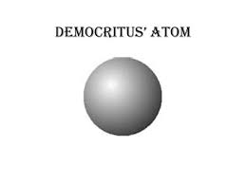

Early Theories
Leucippus (5th century B.C.) and Democritus (460-370 B.C.)
First atomic theory.
All material things consisted of small indivisible particles, or atoms, which were all qualitatively alike, differing only in size, shape, position and mass.
Atoms, they stated, exist in a vacuous space which separates them, and, because of this space, they are capable of movement. (This can be considered at the first kinetic theory.)

Slide 8
Early Theories
Finally, we have moved into a time where the building blocks of matter are thought of as tiny indivisible particles!
Not so fast…
Other famous and powerful Philosophers disagreed with Leucippus and Democritus, including a few you may know of…
Aristotle
Plato
Anaximander
So the world went on believing that all matter was made of earth, air, water and fire.
Based purely on philosophy and not supported by any experimental evidence or observation.

Slide 9

2000 years later…

Slide 10
Atom revived
In 1650, Pierre Gassendi revived the idea of atoms being small, indestructible bodies that aggregate into larger and larger bodies
In 1661, Robert Boyle published his paper – The Sceptical Chymist, in this paper he attempted to question several different assumptions held at that time. “Chemistry” at the time was a lesser science, most “chemists” were focused on make “medicinal” products for sale.

Slide 11
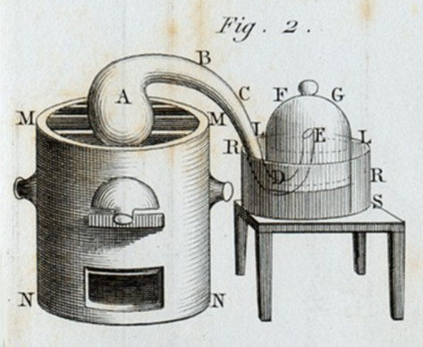
Beginning of scientific evidence
Antoine Laurent Lavoisier (1758-1836) and Anne Pierrette Paulz Lavoiser
Famous for two experiments in particular:
Burnt an exact amount of mercury in an exact amount of air. Giving mercury oxide. The combined mass of the reactants equaled the mass of the products.
Combined oxygen gas and hydrogen gas in a sealed vessel, a static electrical generator provided a spark which produced water. Again there was no change in mass observed
Which law does this sound like to you?

Slide 12
Beginning of scientific evidence
Joseph Proust (1754-1826)
Proust’s experimental work lead to him proposing ‘the law of definite proportions’
He was the first to show experimentally that “different samples of the same compound always contain its constituent elements in the same proportions by mass”
Example: he observed that calcium carbonate always contained copper, oxygen and carbon in a fixed mass ratio of 5:4:1

Slide 13
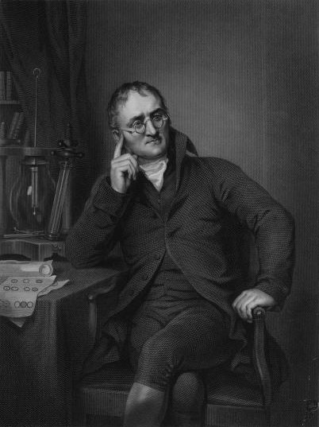
Dalton’s Atomic Theory
Between 1803-1806 John Dalton published his Atomic Theory, it included:
Elements are composed of extremely small particles called atoms
All atoms of a given element are identical, having the same size, mass and chemical properties. Atoms of different elements have a different size, mass and properties
Atoms are not created nor destroyed or changed into different types during a chemical reaction
A chemical reaction involves only separation, combination or rearrangement of atoms
Compounds are formed when atoms combined in a specific ratio

Slide 14
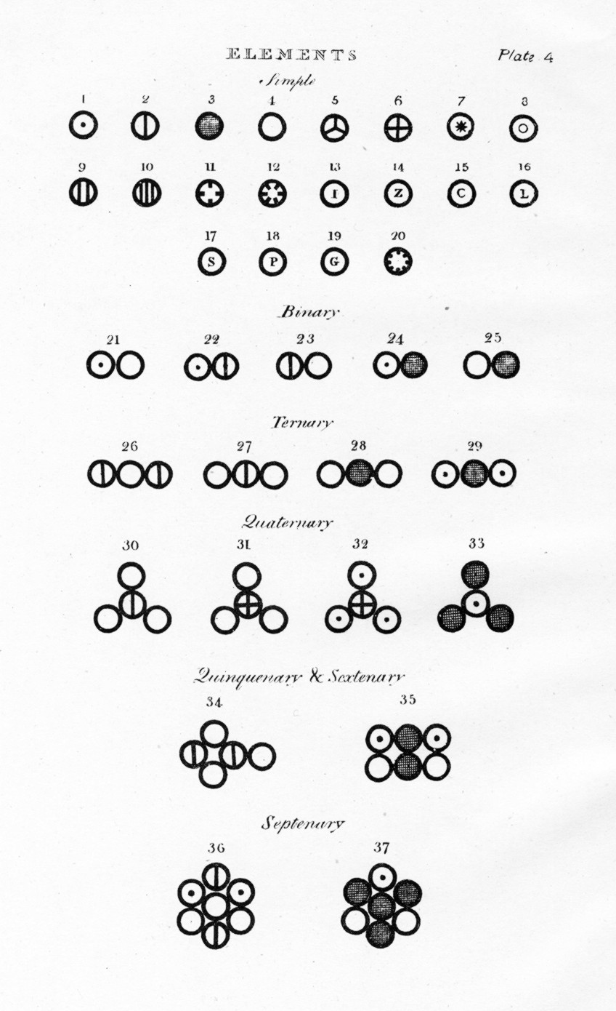
Dalton’s Atomic Theory
Dalton’s idea of an atom:
Brought together and expanded on the experiments of Proust and Lavoisier
Recognized atoms of particular elements differ from other elements
Still thought the atom was indivisible and no concept of sub-atomic particles

Slide 15
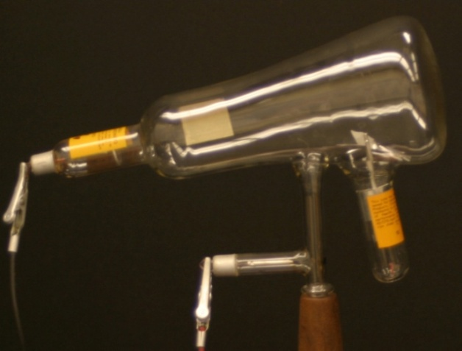
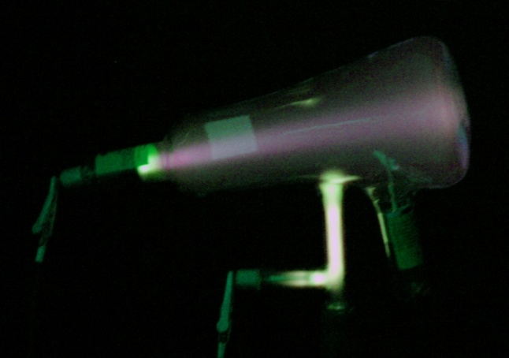
Finding the pieces – The electron
Heinrich Geissler (1814-1879), Julius Plücker (1801-1868) and J. J. Thomson all experimented with cathode ray tubes
A partially evacuated glass tube with a cathode at one end and an anode at the other
When a potential difference was applied the tube glowed – leading to the discovery of cathode rays

Slide 16
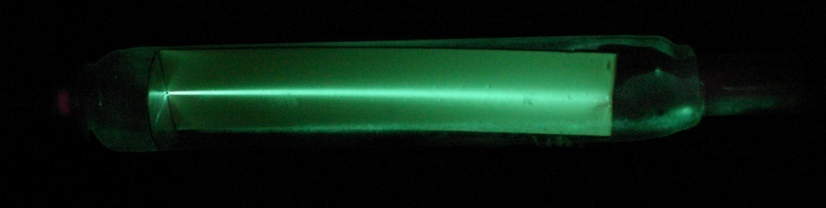
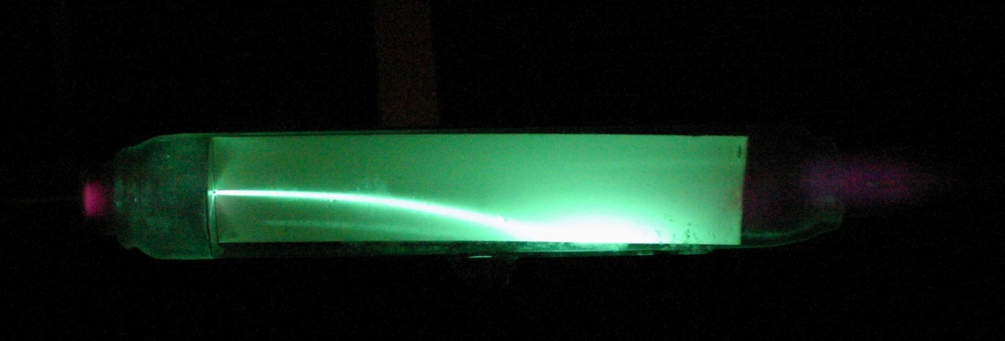
Finding the pieces – The electron
J. J. Thomson observed the cathode rays normally travel in a straight line but if you place charged metal places near the tube, the rays bend towards the positively charged plate
Thomson concluded that “cathode rays” were a stream of negatively charged particles with mass.
Later be called electrons

Slide 17
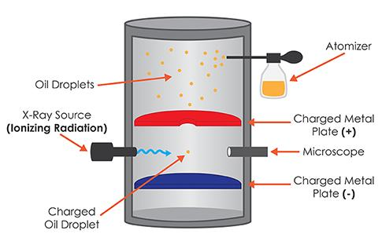
Finding the pieces – The electron
Robert Millikan – discovers the mass of an electron
Performed the “Oil Drop” experiment which allowed him to calculate the mass to charge ratio of electrons
Experiment involved:
Dropping a small drop of oil (which had picked up extra electrons) between two electrically charged plates
He monitored the drops, measured the voltage on the plates affected their fall and then calculated the charge of the drops
The experiment proved that electrons are negatively charge
Also, electrons are about 2000 times smaller than hydrogen (which is the lightest atom)

Slide 18
Revising the structure of the atom
What do we know:
Matter was known to electrically neutral
Thomson had shown they contain negatively charged sub-atomic particles, that were called electrons
A scientist called Robert Millikan (1868-1953) calculated the mass of an electron to be 1/1000th the size of the smallest known atom.

Slide 19

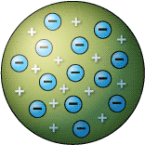
Thomson’s Plum Pudding model
Thomson published his revised theory of the atom in 1904 – we know call it ‘The Plum Pudding model’
In the model atoms were thought to contain numerous tiny, negative particles imbedded in a sphere of positively charge material

Slide 20
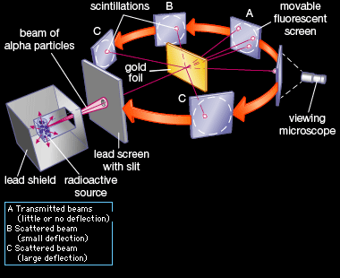
It didn’t last long…
Ernst Rutherford, a new experiment (research done between 1909-1913)
A beam of alpha particles were passed through a thin sheet of gold foil
Expected result – alpha particles would travel in a straight line
What was actually observed…

Slide 21
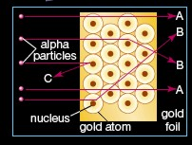
It didn’t last long…
Some alpha particles went straight through the foil, but others were deflected or even reflected back to the source!
Rutherford’s conclusions:
Most of the atom was empty space (hence some travelling straight through)
Areas of very dense matter (caused the deflection)
Thus, the nucleus was discovered!

Slide 22
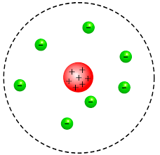
Rutherford’s Atomic Model
Atom is mostly empty space, occupied by mostly the very low mass negatively charged particles called electrons
Has a very dense, positively charged nucleus
Think of what you already know about the structure of the atom. What is missing from this model?

Slide 23
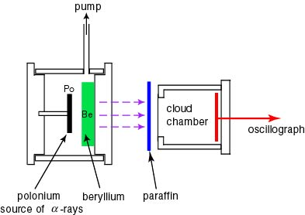
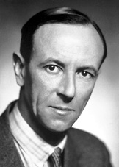
The discovery of the neutron
James Chadwick (1891-1974)
Discovered the neutron – 1932
Used the same experiment as Rutherford, but passed the alpha particles through beryllium
He won the Nobel Prize in 1935

Slide 24
Are we done yet?
What do we know:
Experimental evidence for electrons, protons and neutrons
We know the relative mass of the sub-atomic particles
We think atoms has a dense core composed of protons and neutrons, surrounded by a cloud of electrons
Particle | Symbol | Charge coulomb | Mass g | Relative Charge | Relative Mass amu
electron |  | -1.602 x 10⁻¹⁹ | 9.109 x 10⁻²⁸ | -1 | 0.0005486 ≈ 0
proton |  | 1.602 x 10⁻¹⁹ | 1.673 x 10⁻²⁴ | +1 | 1.0073
neutron |  | 0 | 1.675 x 10⁻²⁴ | 0 | 1.0087

Slide 25
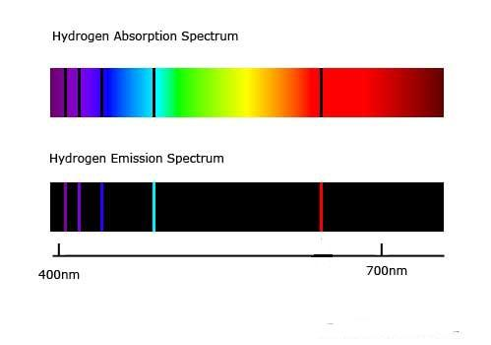
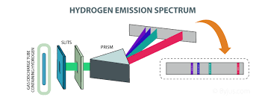
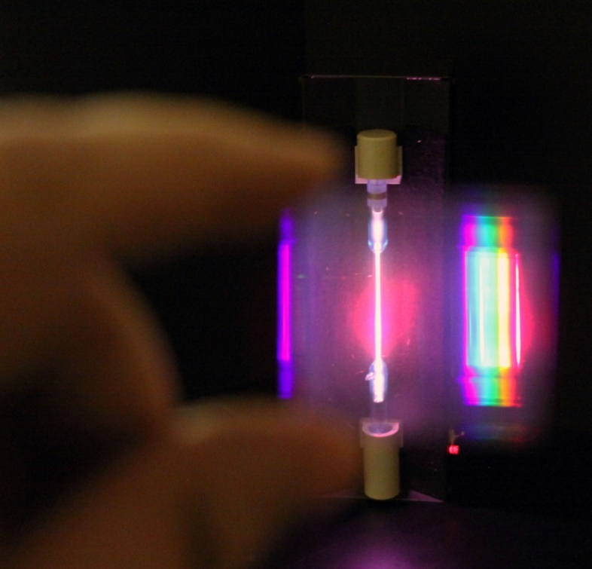
Bohr’s contribution
Rutherford’s model could not explain the observed phenomenon of emission spectra
Produced by electrically excited a low-pressure gas

Slide 26
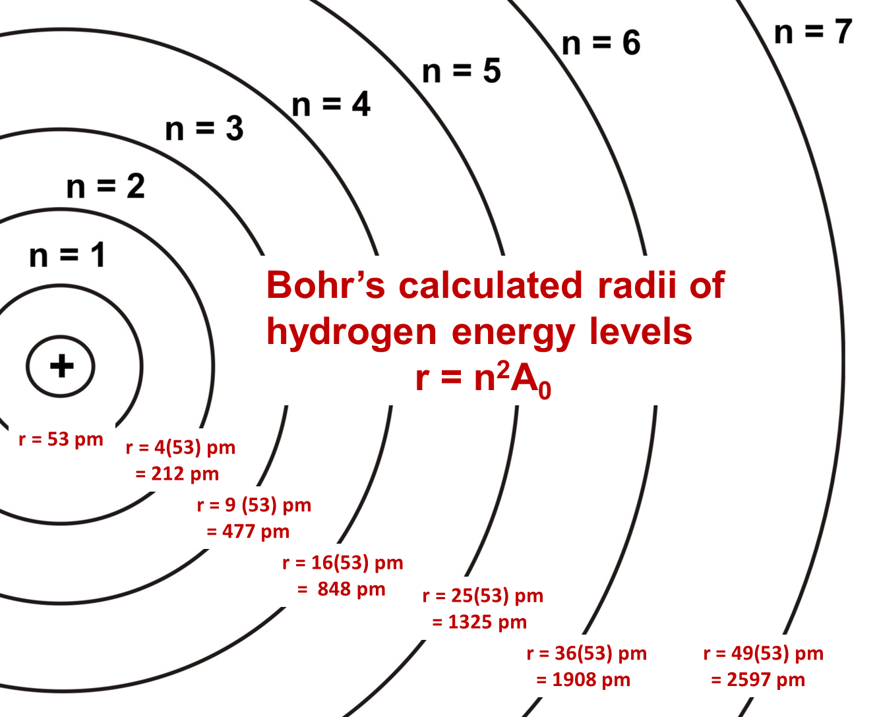
Bohr’s contribution
Also, Rutherford’s model of atoms of electrons orbiting a nucleus would be inherently unstable, the electrons would continuously lose energy in the form of radiation and would be pulled inwards towards the nucleus
Bohr applied principles from a new field of study – Quantum theory
He proposed that each that electrons did orbit the nucleus, but only certain radii were allowed

Slide 27
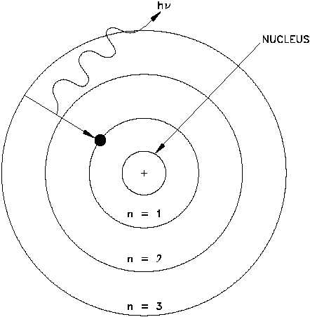
Bohr’s contribution
Electrons at different radii possessed a different amount of energy
Bohr proposed that it was possible for electrons to move to higher energy or lower energy orbits through the absorption or emission of a photon (a package of energy at a specific wavelength)
Thus giving rise to the absorption and emission spectrum we saw previously.

Slide 28
But there was a new problem
Bohr’s theory didn’t explain why the energy levels were quantized or why the lowest energy for an electron was the stable ground state
The model did allow us to predict the emission spectra for simple elements BUT not for atoms that had more than two electrons

Slide 29
Quantum Atomic Model
Through the work of Louis de Broglie, Erwin Schrödinger and Werner Heisenburg the Quantum Atomic Model was developed
In this model electrons are thought of as both a particle and a wave (the same way light it), they do not follow a set path around the nucleus.
Heisenburg proved that if you know the momentum of the electron it was impossible to know the position, and vice verse.
Therefore, we don’t have electrons orbiting the nucleus like planets around the sun, instead we have areas of probability where an electron could be found – we call these areas orbitals

Slide 30
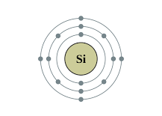
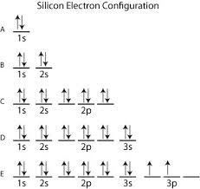
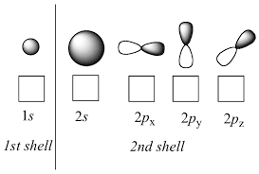
Quantum Atomic Model

Slide 31
Conclusions
You need to be able to explain the different Atomic Models, starting from Dalton’s. This includes what experiments were done, what was observed, what conclusions were reached and what model did that lead to
For this course you are NOT expected to understand orbitals, such as s, p, d, f orbitals but you do need to be able to draw and write the electron configuration for the first 20 elements on the periodic table (based on a Bohr style representation of the atom)

